Slide 1
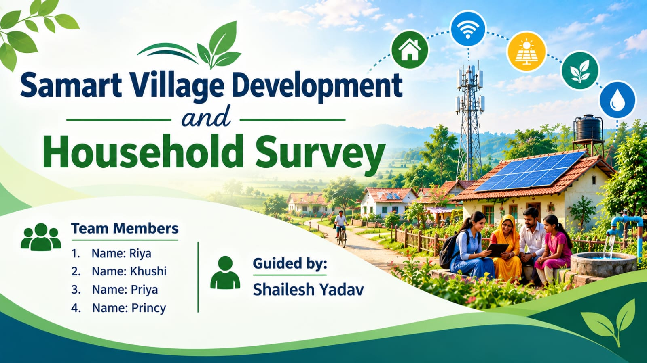




S

Slide 2

Collecting household information manually is time-consuming and difficult to manage.
It is difficult to track basic facilities such as electricity, water, and toilets.
Information about internet, smartphones, banking, and UPI usage needs proper analysis.
Comparing education, occupation, and monthly income across households can be difficult without organized data.
Village development data can be difficult to understand and compare when it is stored in raw or unorganized form.

Slide 3
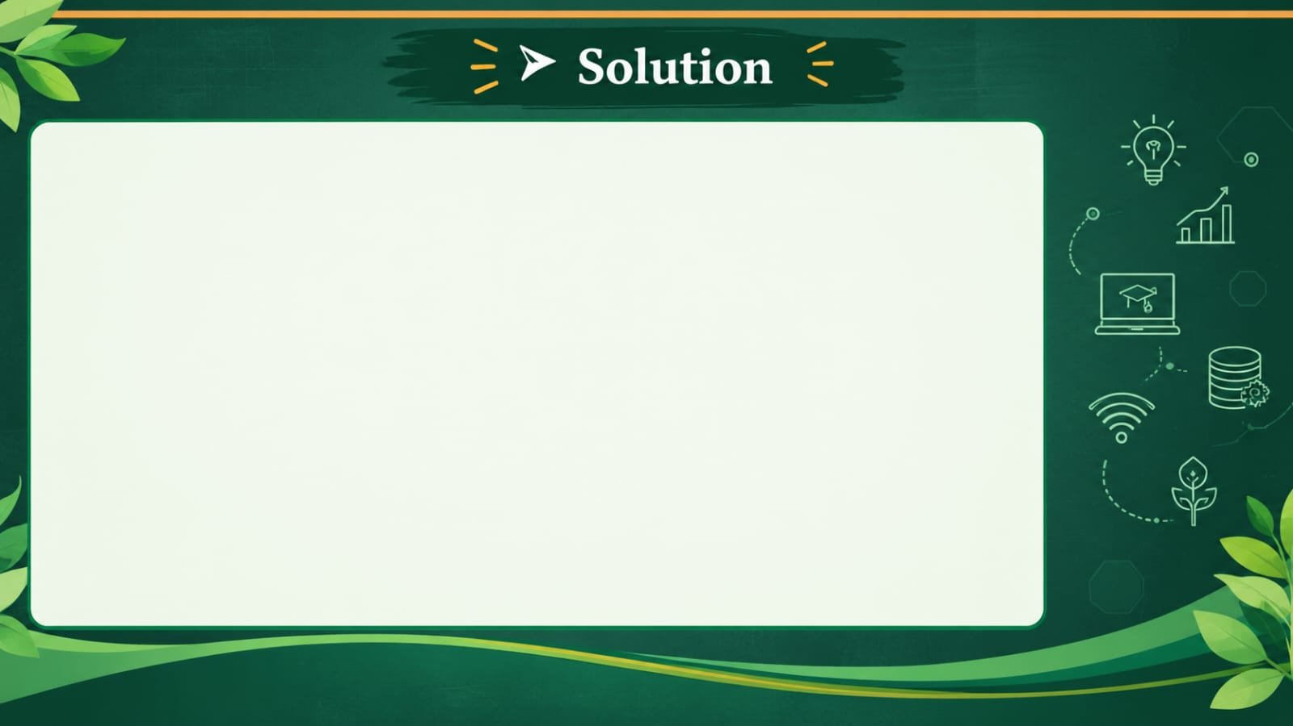
Use an Excel database to store and organize all household information in one place.
Create separate columns for each facility and use formulas to calculate their availability.
Use Excel functions like COUNTIF and percentage calculations to analyze digital facility usage.
Use sorting, filtering, formulas, and PivotTables to compare and summarize household information.
Use charts, conditional formatting, and a dashboard to present the information clearly and identify areas that need improvement.

Slide 4
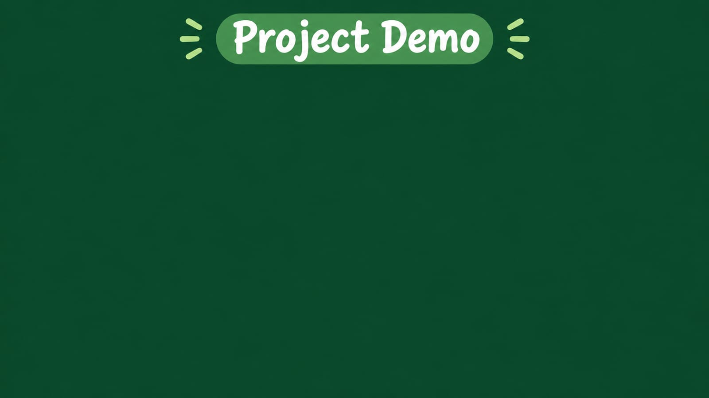
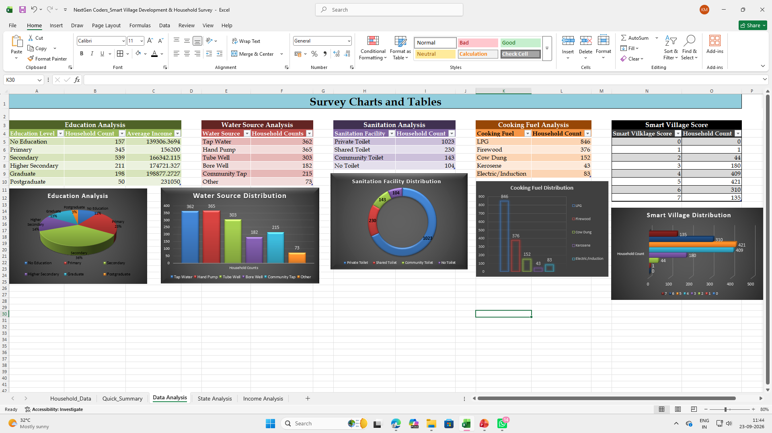
GitHub Link

Slide 5

Digital Village Dashboard – The system can be converted into an interactive dashboard for real-time village data analysis.
Mobile Data Collection – A mobile application can be developed to collect household survey data directly from the field.
Government Scheme Tracking – Future versions can include information about government schemes and their coverage among households.
Data-Based Development Planning – The collected data can help identify areas that need improvement, such as internet, water, sanitation, or digital services.
AI-Based Analysis – In the future, AI can be used to analyze survey data and provide development insights and recommendations.

Slide 6

This project helped us collect and organize household data in a systematic way. By analyzing education, occupation, income, electricity, internet, banking, UPI, water, and sanitation facilities, we gained useful insights into village development.
Using Excel formulas, sorting, filtering, charts, and PivotTables made the data easier to understand and compare. Overall, this project shows how data and technology can support better decision-making and contribute to smart and sustainable village development.

Slide 7

Notes:
Thank You !!

